Slide 1
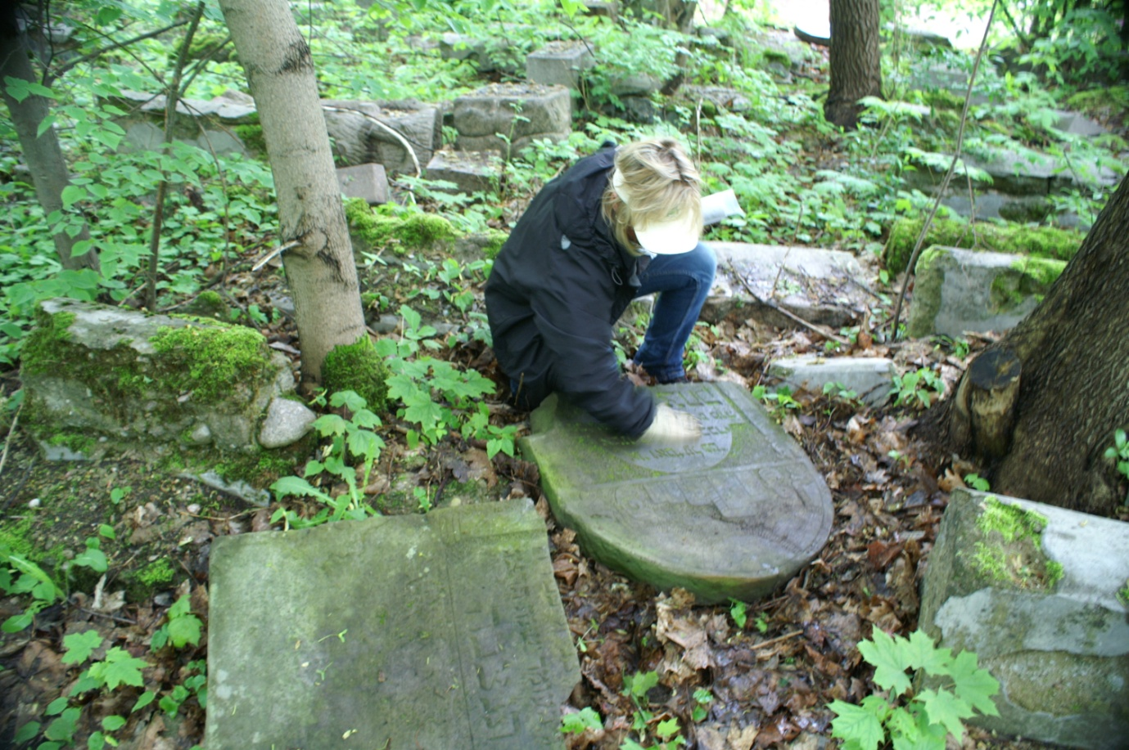
The Jewish Epitaph Reconsidered: Towards Reversing a Century of Condemnation
Notes:
TO NORM, CONCORDIA: PORTLAND, and St. Michael’s – Thank you for kind welcome, wonderful accommodations on campus and the use of this sanctuary and community room tonight.
I can’t play the piano or an instrument for that matter, but a little reflection is in order before I turn to my address tonight.

Slide 2
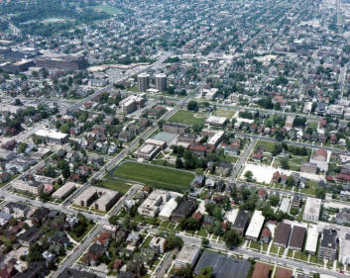
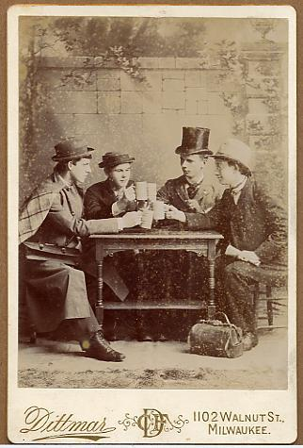
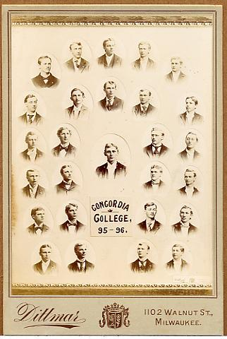
Concordia College Milwaukee
Notes:
I began my teaching career at the then Concordia College in Milwaukee, Wisconsin in 1980 (at the young age of 10 x 2), teaching Biblical Hebrew in their pre-seminary program. Concordia – long history of academic excellence and pre-seminary program. At the same time I was just beginning my first master’s program in Hebrew Studies at the UW-Milwaukee. Expecting to be taken on as a TA, I discovered I was the instructor of record with full-responsibility for preparing my students for their Hebrew examinations for the seminary. The confidence and trust Concordia offered me proved to be an extraordinary teaching environment for 8 years. Had Concordia needed a full-time professor for Hebrew Bible, I probably would have gone no further in pursuit of teaching positions.

Slide 3
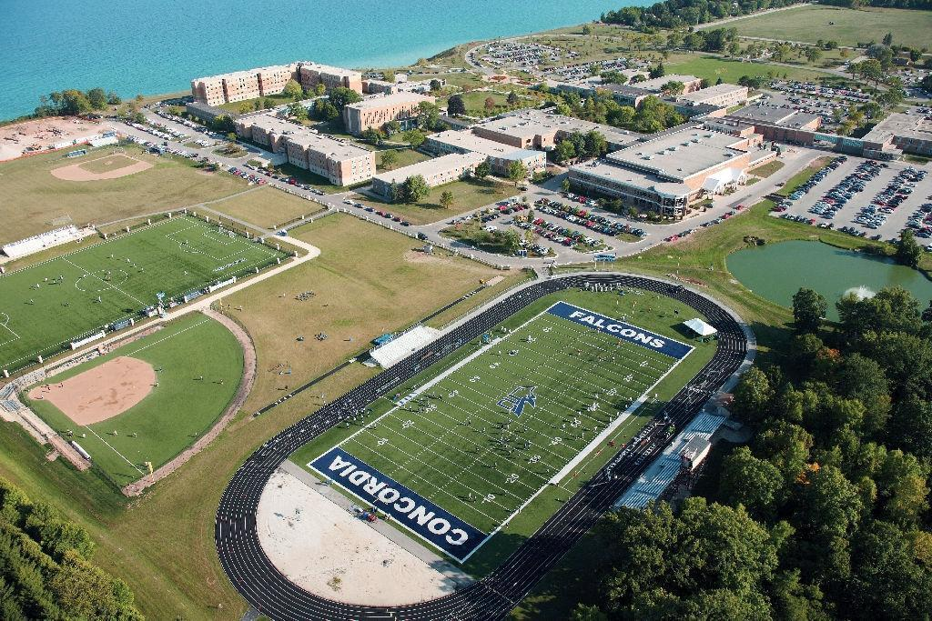
Concordia University Wisconsin
Notes:
Today, Concordia continues to grow after relocating to Mequon, Wisconsin in the late 1980’s. Fortunate to have taught three years on this beautiful campus.

Slide 4
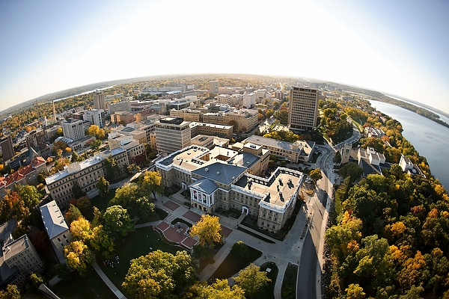
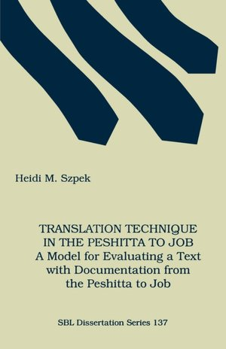
University of Wisconsin-Madison
Notes:
TO HEBREW SCRIPTURES SESSION MEMBERS:
As those of you who frequent the Hebrew Scriptures sessions know, my research began focused on the book of Job. My dissertation ---- was followed by a series of articles on translation theory in Peshitta to Job and the Targumim, and the Septuagint, a number of articles on the Peshitta to Job. I’m pleased that my dissertation is still cited in discussions of the Peshitta to Job – though published in 1992 this also means for young scholars out there, it’s time someone seriously advanced beyond what I offered!
You may also notice that none of these publications dealt with meaning of the book of Job. Last year, for those in attendance at our meeting, my doctoral mentor Michael V. Fox delivered a most profound banquet address on the meaning of the book of Job. For me Michael’s words significantly advanced my thoughts on Job (and I also was pleased to have Michael correct my memory. For 25 years I seemed to recall that I had written a rotten paper on the meaning of Job for Michael’s class in grad school).
I’ll be returning to Job is a moment.

Slide 5
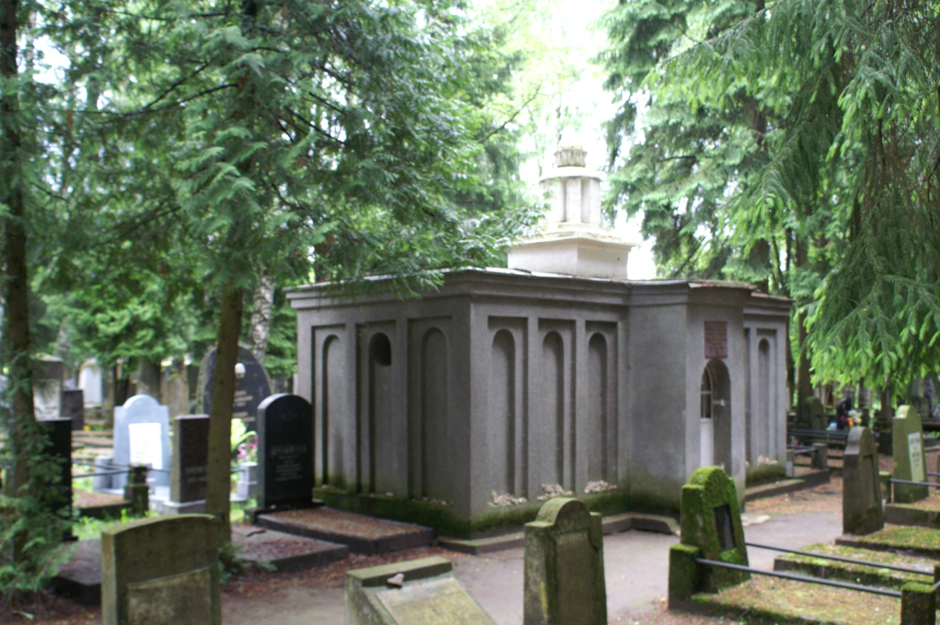
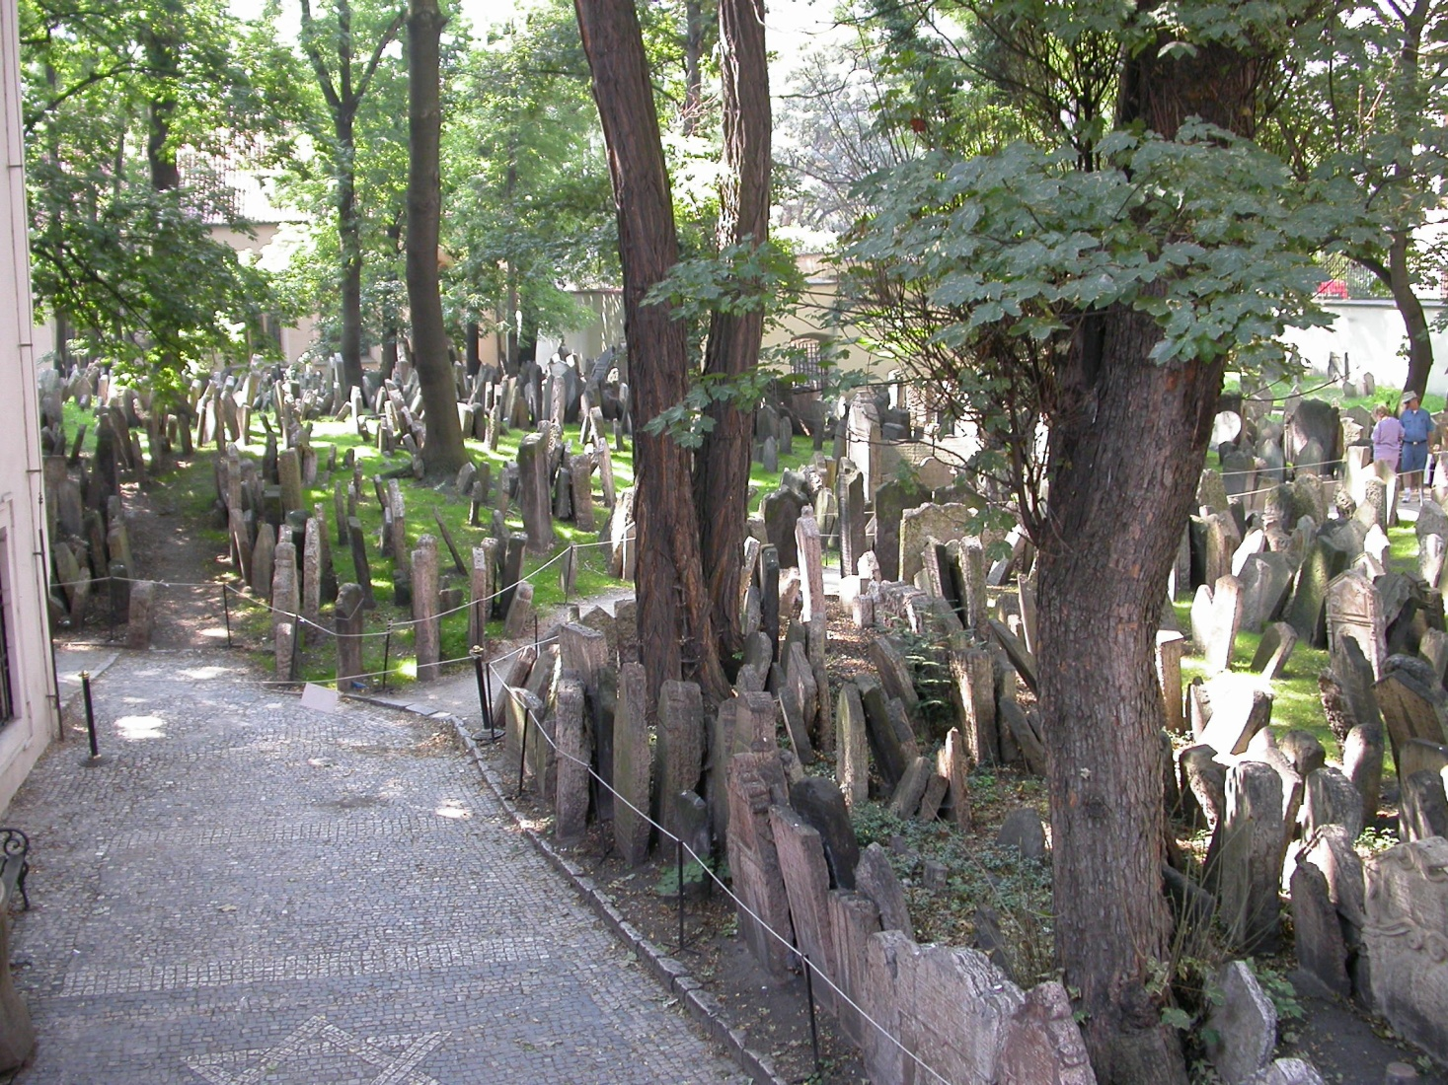
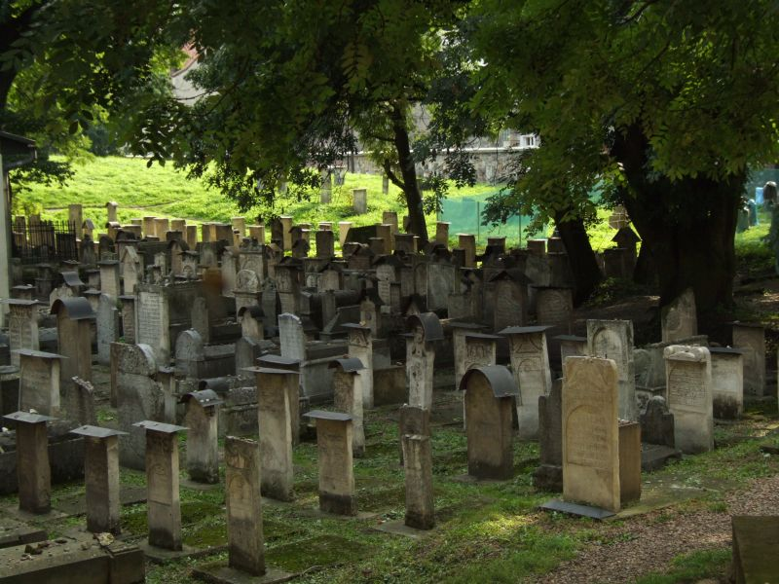
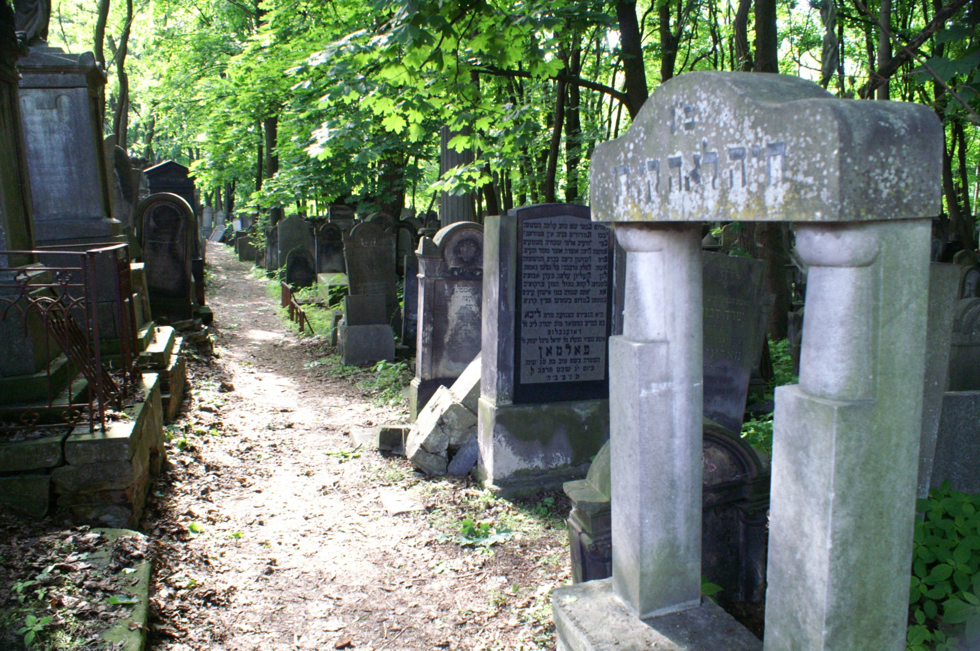
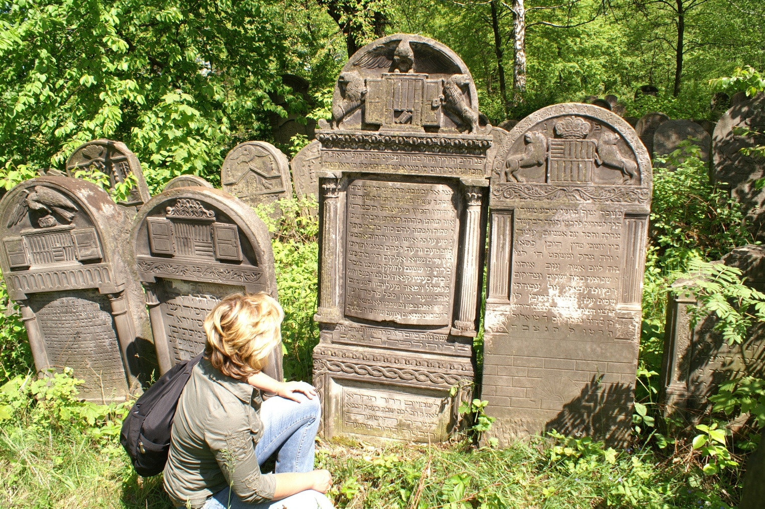
The Jewish Cemetery
Notes:
For many, thoughts of Jewish cemeteries, especially in Eastern Europe, bring recollections of closely packed final resting places, sometimes neatly aligned rows or sections, such as in Prague, or Kazimierz (Krakow) or the exquisitely executed matzevoth at Szydlowiec (Jewish Heritage site east of Warsaw), mausoleum’s (ohel) of distinguished rabbis in Vilna, or the 250,000 burials in Warsaw, marked by such incredibly variety of styles and epitaphs.

Slide 6
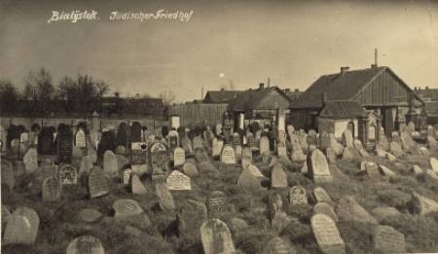
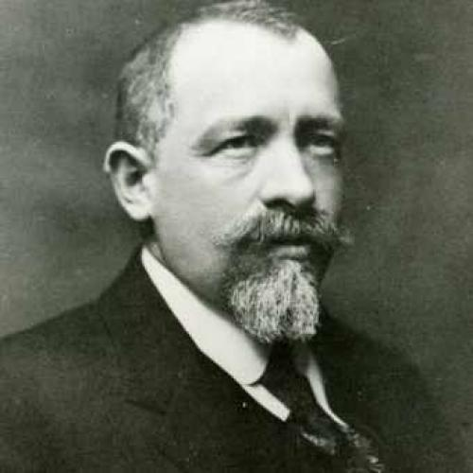
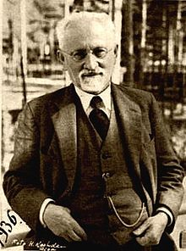
The Jewish Epitaph Reconsidered: Towards Reversing a Century of Condemnation
Mejer Bałaban
Simon Dubnow
Notes:
However, there are also hundreds of small shtetl cemeteries. It is the little shtetl cemetery of Kolbuszowa, east of Krakow , in which I first gave serious attention to the Jewish epitaph. Indeed, it is the description of Job in the book of Job as “perfect and upright, God-fearing” and “an old man, full of days” that first caught my attention inscribed upon a Jewish epitaph in this cemetery – along with exquisite acrostic poetry.
The title of my address tonight is “Jewish Epitaphs Reconsidered”, which to most would seem a far distance from where my original scholarship began. However, it is and is not. The book of Job is a key text that explores innocent suffering. In the progression of institutions at which I’ve taught since Concordia circumstances have necessitated that I moved beyond the teaching Biblical Hebrew to courses on World Religion, Sacred Literature, the Hebrew Bible, courses on Judaism, Jewish Literature and ultimately courses on the Holocaust. In each of these courses exploring the nature of human suffering is inevitable to various degrees and Job – perhaps much to the eventual annoyance of my students was frequently introduced. An this journey in teaching brought me to Eastern Europe; my studies of ancient languages drew me to consider the value of what was written upon these matzevoth – always remembering that these stones mark the final resting places of the Jewish men, women and children who belonged to these communitiesl
So back to the title of tonight’s address and subtitle. In the early 20th century, Polish historian Mejer Bałaban delivered a most telling condemnation of Jewish epitaphs as “blatantly baroque”, “overloaded with epithets” and difficult to understand. Balaban brief comments may have been prompted that by a slightly earlier open letter in 1892 by the maskil Simon Dubnow. Dubnow had delivered a plea to the maskilim (intellectuals) and mithnagdim (traditionalists) of his day to engage in documenting and writing the woefully lacking past history of Yiddish civilization as a means to unite past history with emerging nationalistic inclinations. Dubnow specified gathering epitaphs as part of this documentation. Such was taken up, for example, in the Pinkus Bialystok and other town chronicles throughout Eastern Europe. Despite Dubnow’s plea it is Bałaban’s condemnation that has held sway in American and English-speaking European academies and which has not yet been fully reversed in the scholarship of the century to follow. In the spirit of Dubnow, my research in tonight’s address offers select examples by which we can move towards establishing the potential Jewish epitaphs hold as another evidentiary source, corroborating or enriching Jewish history, and for me part of an ongoing intellectual journey is pursuit of a meaning to Job.

Slide 7
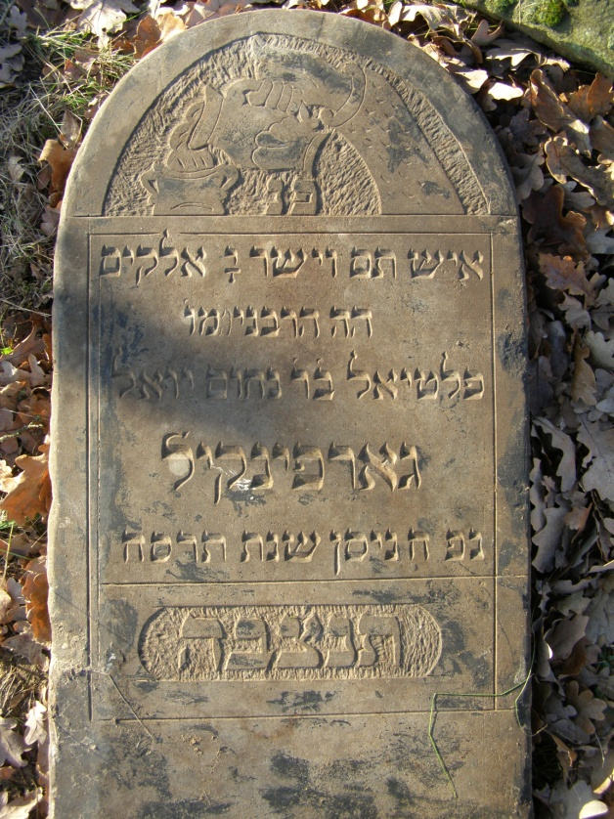
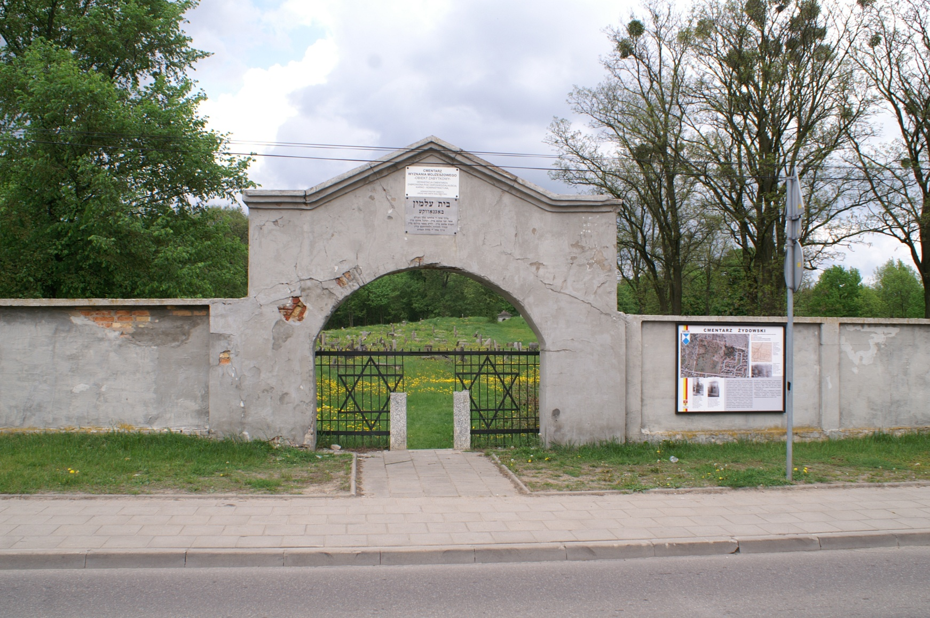
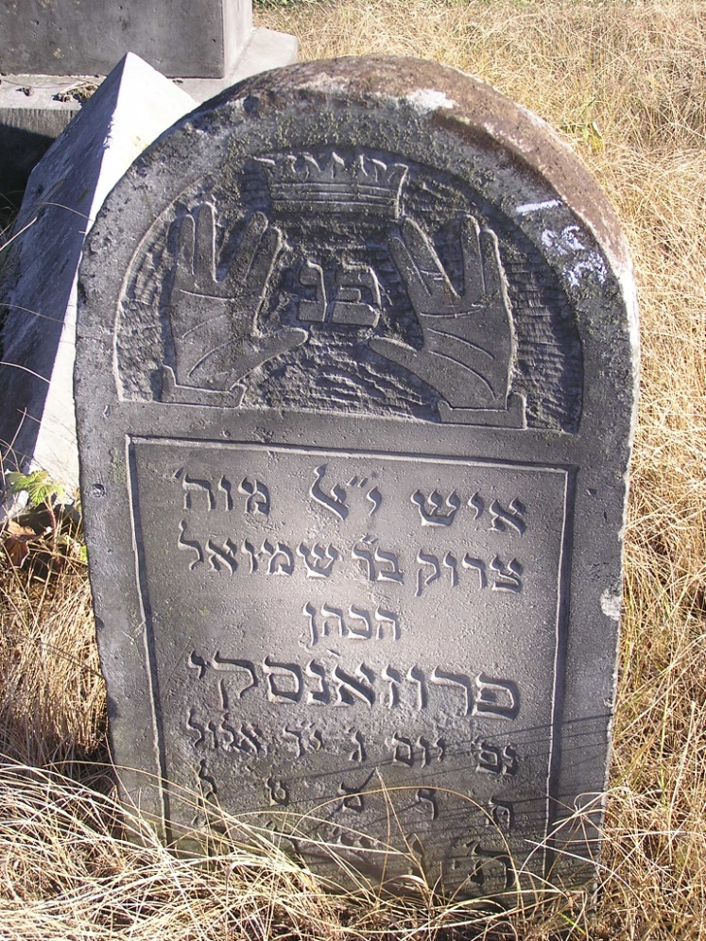
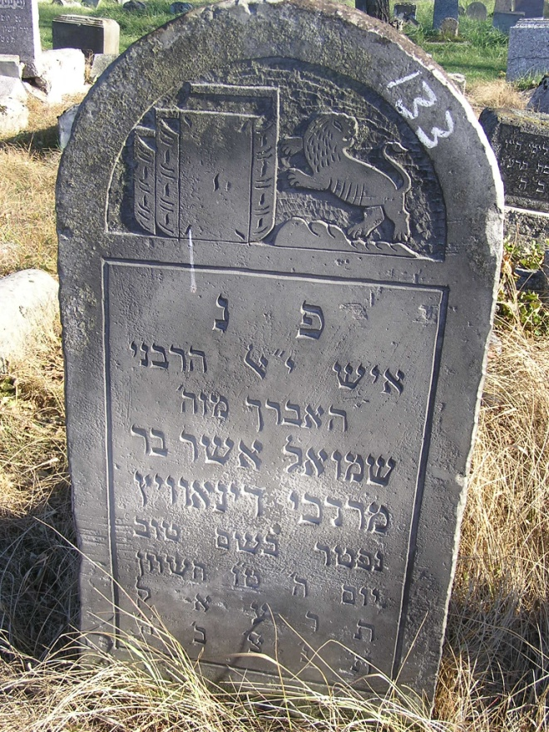
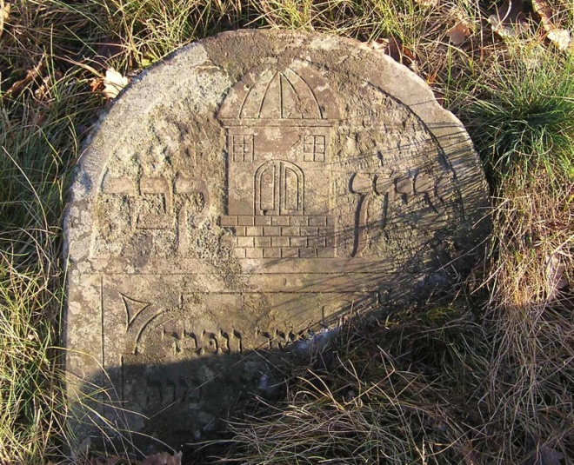
Bagnowka Beth Olam Białystok, Poland
Notes:
At present the focus of my research is in Bialystok today NE Poland. Bagnowka founded in 1892, a progressive Jewish cemetery, situated beside a Roman Catholic and Eastern Orthodox cemetery. Labeled progressive because traditional conventions were not maintained, e.g. cohahim and Levites need not be buried near the entrances, sections will contain the graves and matzevoth of women and children; indeed the epitaphs will range from most traditional (emphasis on specific attributes, Torah and Talmud study for men, charitable deeds and Eshet Hayil qualities for women) to styles influenced by modernity or perhaps Christian epitaph (just name, date of death). Bagnowka eventually held the remains of 40,000 members of predominately Bialystok’s Jewish community; today about 2300 remain.
Next two video clips you’ll see the contrast of then and now.

Slide 8
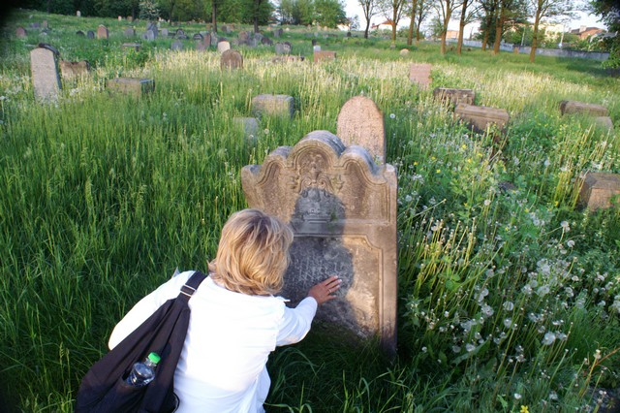

Slide 9
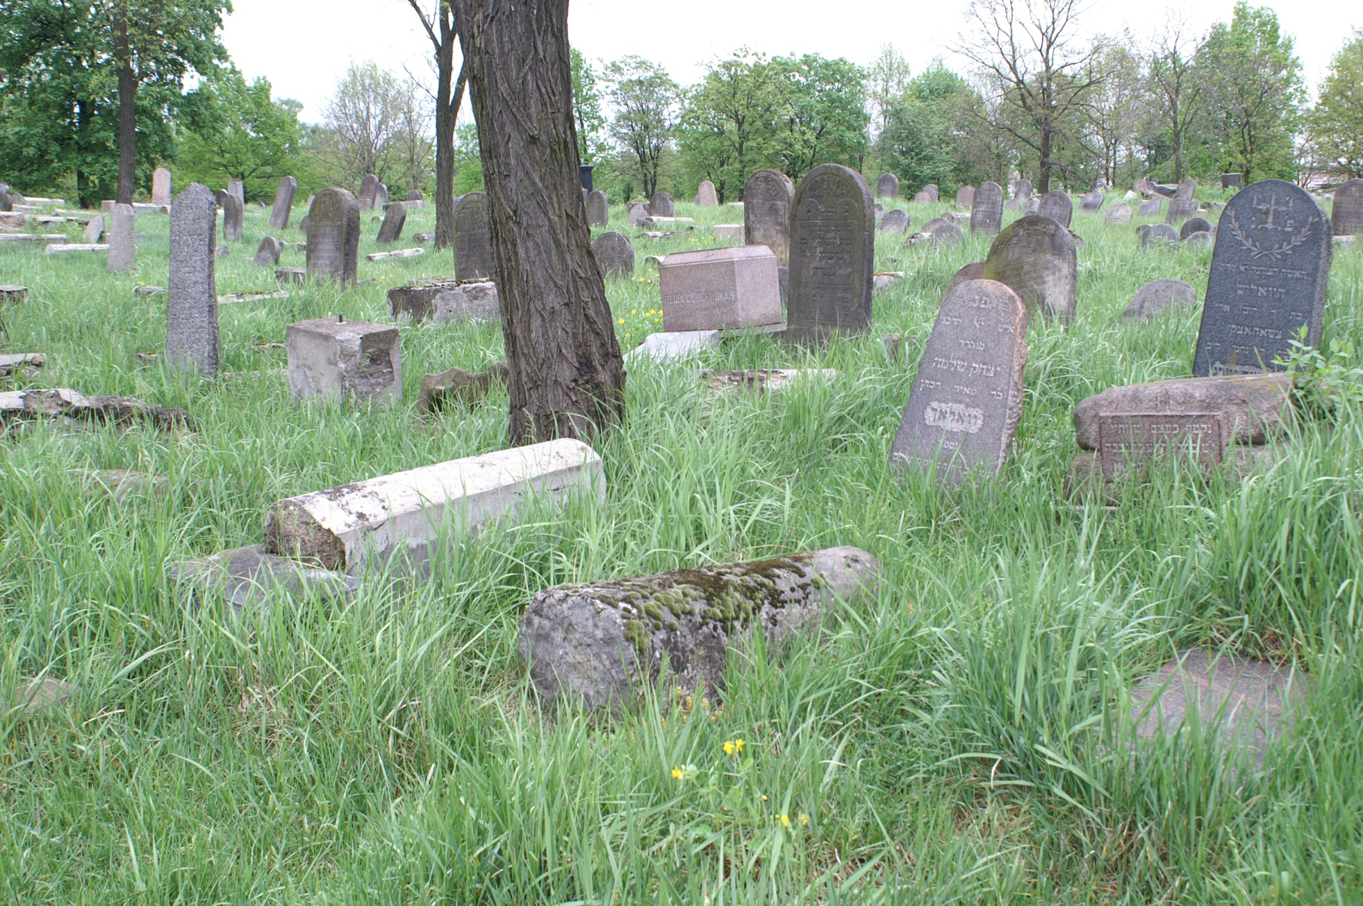
Notes:
2005

Slide 10
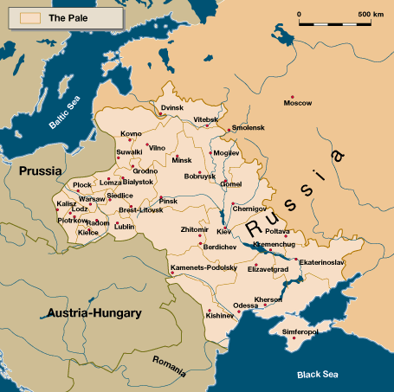
Notes:
Pattern of migration: 16-17th move to Wild East, fleeing persecution in Western and Central Europe
18th and 19th, reversal in movement, in part due to forced movement into the Pale, but earlier by choice to urban centers like Bialystok

Slide 11
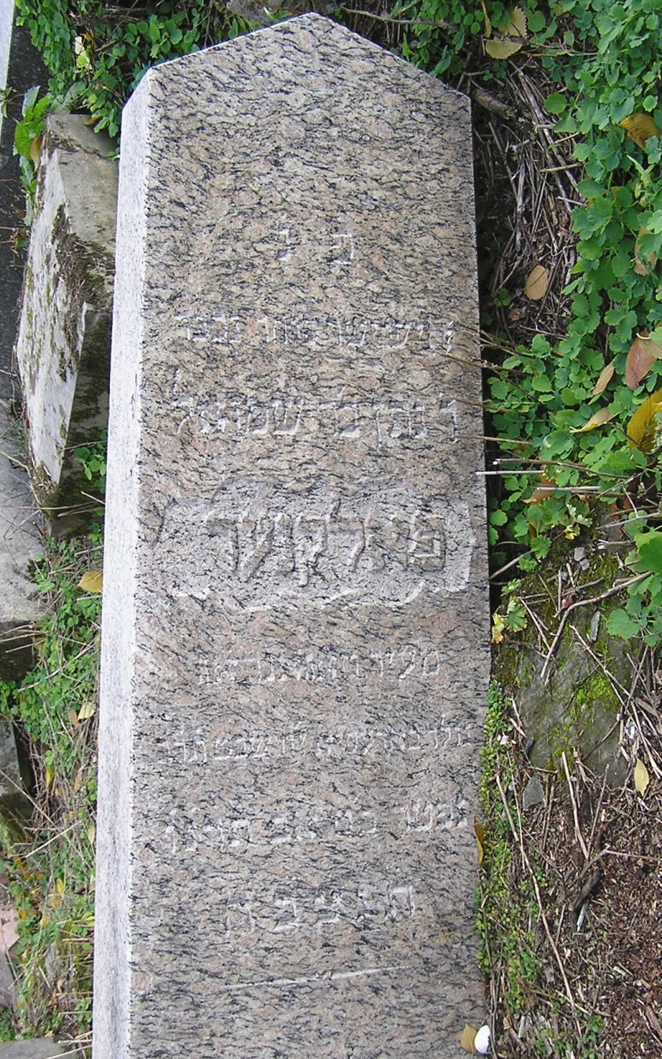
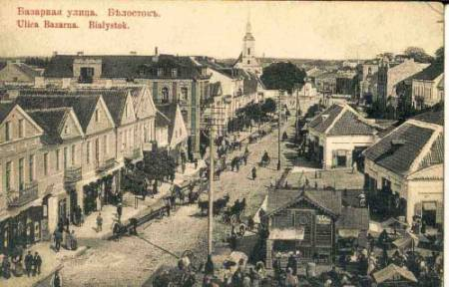
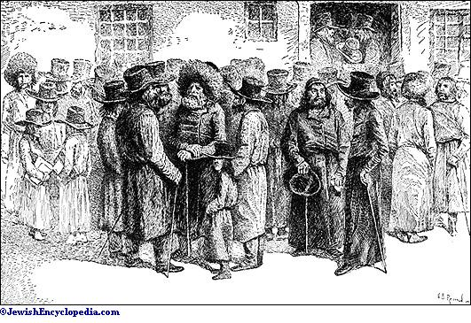
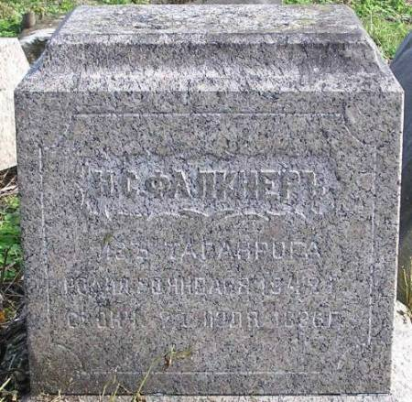
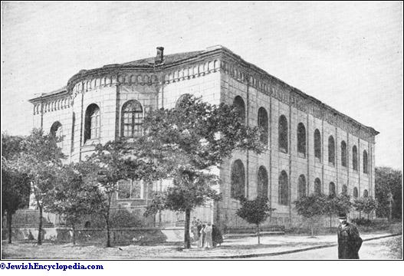
Migration: Odessa-Taganrog-Bialystok
Notes:
“Drawn to Białystok by the economic and cultural opportunities it offered, Jews streamed into the city,” wrote Rebecca Kobrin in Jewish Białystok and Its Diaspora, causing the city’s population to swell ninefold from 1807 to 1914. Kobrin notes that Jews migrated from “hamlets” near, from “burgeoning cities” as far away as Minsk, even from “locales outside the Pale of Settlement, such as Konigsberg in Prussia”. The epitaphs from Bagnowka Beth Olam bears witness to the migration of which Kobrin writes. Movement to Białystok is in evidence in Bagnowka epitaphs from such distant cities as Odessa, Starokonstantinov and Brest Litovsk; from the regional centres of Grodno, Vilna and Lvov; and from a dozens near and distant shtetlekh (small towns). From the burgeoning mercantile port of Odessa on the Black Sea, for example, the epitaph of Nathan Falkner records his immigration, by simple inclusion of a place name:

Slide 12
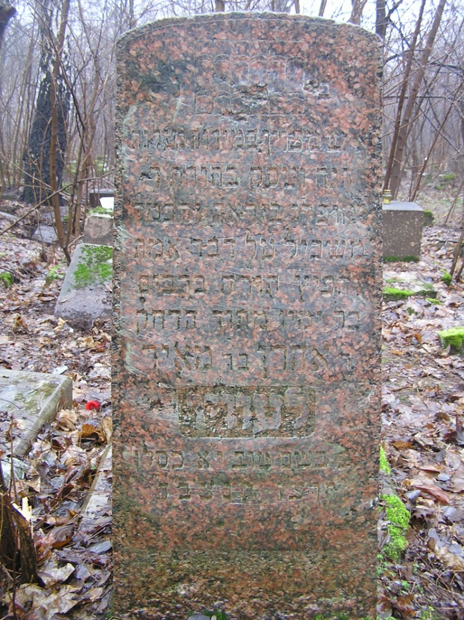
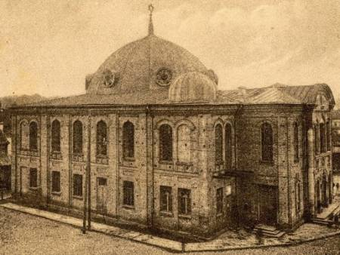
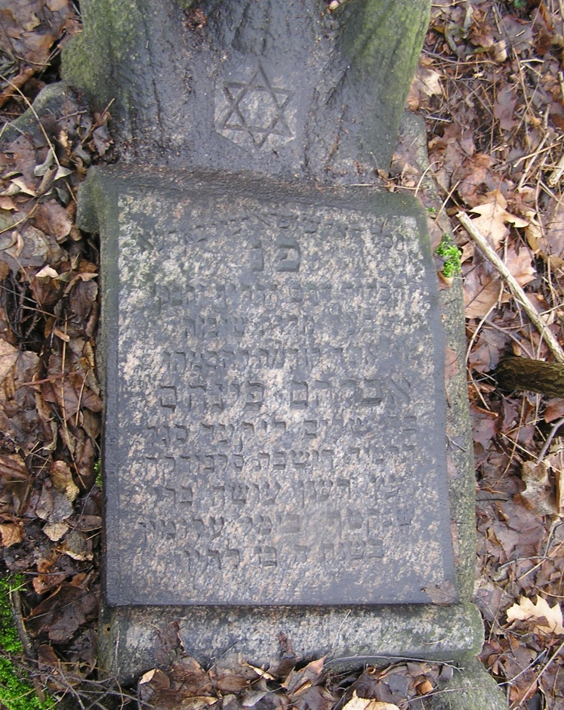
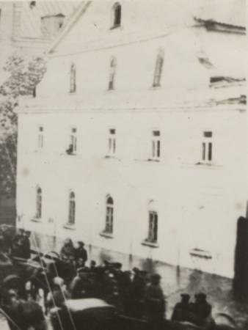
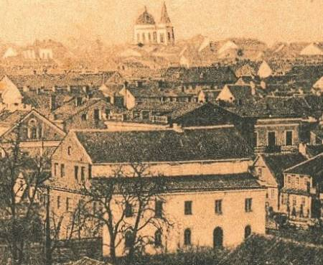
Religious Diversity
Notes:
the pacesetter of the intelligentsia was the Talmudic scholar, who possessed vast halakhic erudition and set a high moral example. The scholar spent his free time studying the Torah, distancing himself as much as possible from the alien technical culture of Western Europe … The scholar, therefore, not the rich man, enjoyed the greatest prestige within the Jewish community. Material possessions and economic power did not confer nobility; knowledge did, coupled with clean liv­ing based on Torah principles.”
Such will soon change with the Hasidim and adherents of the Haskalah, as well as socialist movements (Bundism & Zionism) plus rapidly increasing industrialization ... Result a dire need to return to focus on Torah, Talmud, times for meditation and a return to social values.
"Here lies a man dedicated in charitable deeds, compassionate and engaged in Torah of God, prominent in Fear [of God] and wisdom, intelligent regarding truthful words and [one] who spread Torah with whispers all his days amidst the need, R. Aaron son of R. Meir Lewin. He died in a good name 11 Kislev 5697 [25 November 1936]. May his soul be bound in the bond of everlasting life."
Abraham Pinhas son of Shalom Liker Segel, a student of the yeshiva of Slobodka, who was “plucked up in the violence of his days”, in November of 1933The yeshiva of Slobodka, where Abraham Pinhas studied, was located in what is now present day Kovno, Lithuania. In the yeshivot of Slobodka the Musar movement began in the mid-19th century, attributed to Rabbi Israel Lipkin Salanter. On moving to Bialystok, Abraham Pinhas may have continued his study at the Musar yeshivah of Beit Yosef which embraced an even more rigorous program than that originally advocated by Rabbi Lipkin. The Musar movement arose from traditional circles (mithnagdim) in response to the social changes of the Haskalah (Enlightenment). With its emphasis on ethics, the Musar movement embraced a philosophy that sought to gently return the Jew to an ethical life centered on living quietly in accordance with the teachings of Torah, a life that seemed to be almost imperceptibly disappearing as the bustle of new social engagements and commitments overwhelmed their daily life. The Musar movement was especially directed at guiding young people such as Abraham Pinhas. As its founder R. Lipkin wrote in his first letter to the Vilna community in 1849:
"The busy man does evil wherever he turns. His business doing badly, his mind and strength become confounded and subject to the fetters of care and confusion. Therefore appoint a time on the Holy Sabbath to gather together at a fixed hour... the notables of the city, whom many will follow, for the study of morals. Speak quietly and deliberately without joking or irony, estimate the good traits of man and his faults, how he should be castigated to turn away from the latter and strengthen the former. Do not decide matters at a single glance; divide the good work among you-not taking up much time, not putting on too heavy a burden. Little by little, much will be gathered ... In the quiet of reflection, in reasonable deliberation, each will strengthen his fellow and cure the foolishness of his heart and eliminate his lazy habits."

Slide 13
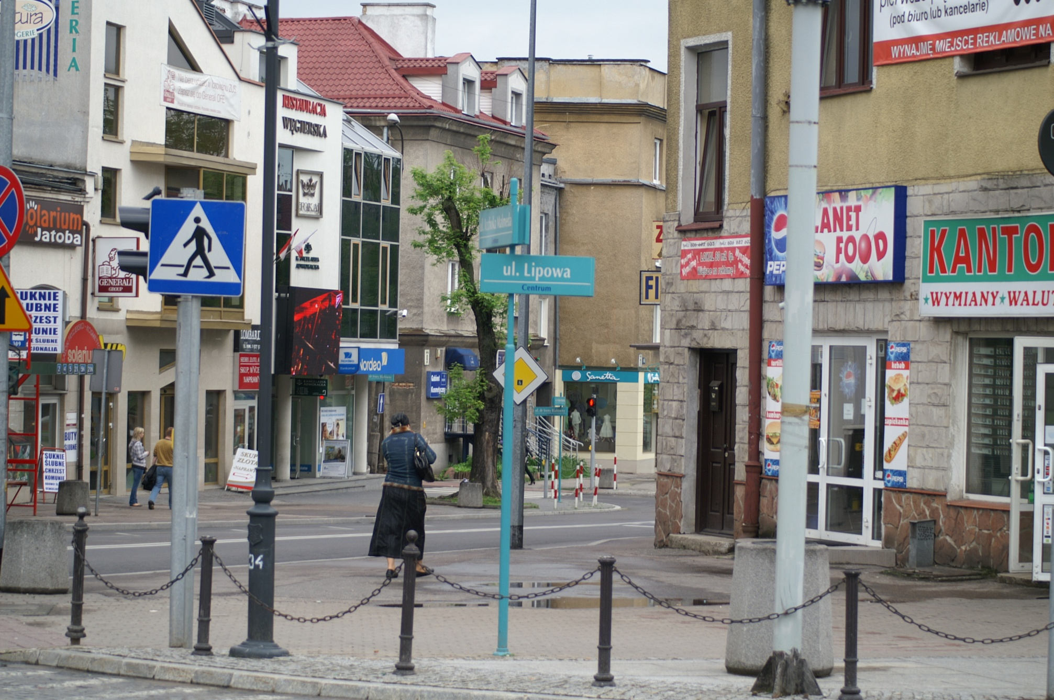
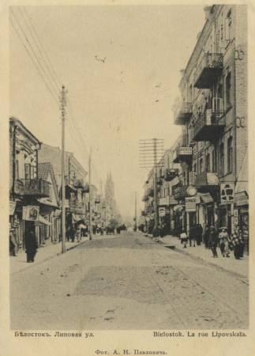
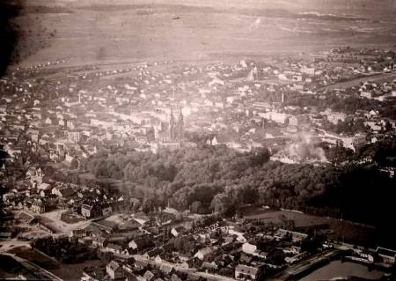
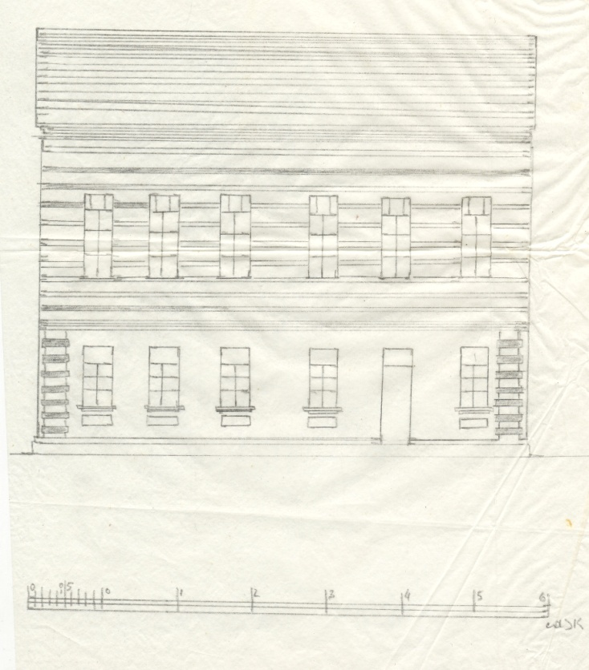
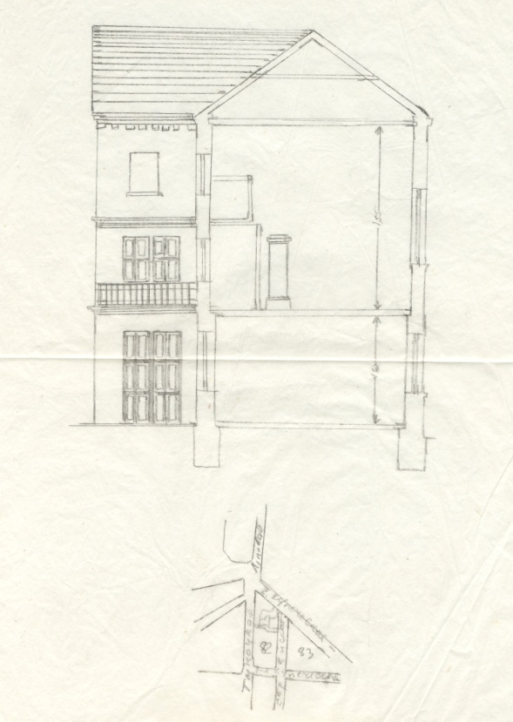
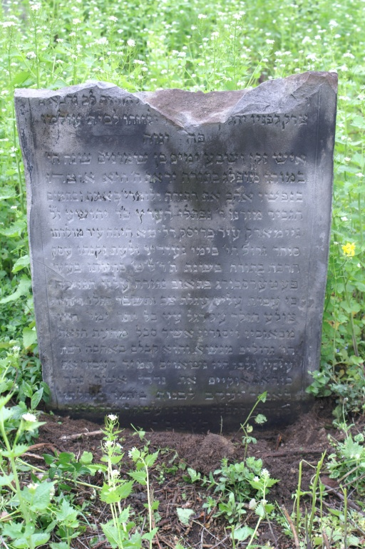
Nejmark Beth Midrash
Notes:
Here rests an old man, full of days, 80 years old he was at his death, prominent in Torah, Fear of the Lord was his treasure. In his soul he loved the Torah and study of the Lord – in surety and in perfection, the esteemed man, our teacher Reb Naphtali Hertz, son of R. Joshua of blessed memory, Nejmark. The city of Brisk Dłita was the city of his birth. He was a great merchant in the days of his youth and during the time of his old age he engaged much in Torah. In the year 5639 [1879], he was in the city of Petersburg and suddenly a decree was enacted on behalf of him because an upholstered wagon (i.e. trolley car) crossed over him and it shattered his leg. [And so] he walked haltingly upon a wooden leg (i.e. cane) all the remaining days of his life. His pains and his sufferings which he endured from this time were the greatest of burdens, but he carried them with great love. His eyes and his heart bore them eternally for the sake of his Creator. He maintained his vow which he made for the noblest of Jacob to build a house of study with his inheritance, for Torah and for prayer. He died Friday, the eve of the Holy Sabbath, 20th Tevet 5654 [1894]. May his soul be bound in the bond of everlasting life.
Reb Napthali was born in the city of Brisk D’łita (Polish Brest-Litovsk or Brest) in 5574 [1814], a city renowned as the place of origin for the Soloveichik dynasty of rabbinic scholars and their yeshivas, and for trade and commerce. Reb Naphtali’s life seemed to mirror the character of his birth place; he was both “a great merchant” and a man deeply devoted to Torah study. In the latter years of his life he physically suffered from an accident that occurred in (St.) Petersburg in 5639 [1879], at the age of 65. However, Reb Naphtali would live on until age 80, dying on the eve of the Holy Sabbath, 20th Tevet 5654 (29 December 1893). Like the biblical Job, he was “an old man, full of days” (42:17). His inscription records that though he “walked haltingly” on a “wooden leg”, i.e. a cane, the remainder of his life, Reb Naphtali seems to have bore his sufferings with endurance – again like the biblical Job. Yet why were these details preserved on his matzevah, specifically the details of his accident and ‘wooden leg’? (Figure 16) Reb Naphtali had “maintained his vow which he made” to finance the building of a beth-midrash with his inheritance. According to his epitaph, Reb Naphtali vowed even before his accident to build a beth-midrash. His accident seems to have reaffirmed this vow. In 1901 – seven years after Reb Naphtali’s death, his house of study Nejmark Beth HaMidrash, located on Kupiecka Street (current Malmeda Street) in Białystok, was built and dedicated. Though his date of birth is not provided, his date of death [5654] and length of life [80 years] are provided to establish a date of birth. This inheritance may be connected with a debt exaction to his father as preserved in the Byelorussia National Historical Archive. Fond 2, Opis 2 (1806-1815) entry 636.

Slide 14
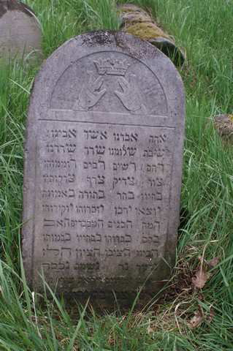
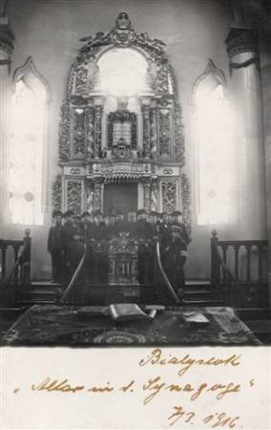
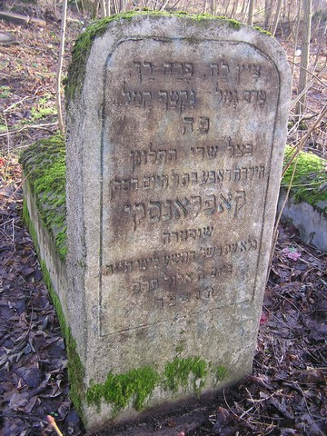
Poetry
Notes:
One such inscription in Section 76 told of the violent death of Dobe, the nine year old daughter of Reb Chaim Kaplański. Dobe was killed on 19 August 1920 in Bialystok, amidst the violence that assailed the Jewish community as the Red Army entered Bialystok in late July, just three days before the Polish army recaptured the city. Her inscription begins with a poem: "A blossom is fresh, a flower is tender. Before it fully ripened, it was plucked, it was killed.” This beautiful first stanza, likening this precious daughter to a fresh blossom and a tender flower, is ever so quickly shattered by the imagery which follows. This little girl, Dabe, had not yet ‘ripened’. She had barely experienced a decade of life before she was killed. Dabe was denied life.
[A] Alas! [A] We have perished (because of) [A] Asher [A] our father!
[Š] Has ended [Š] our peace! [Š] the destroyer(?) [Š] has destroyed us.
[R] He loved [R] (the) poor; [R] many [R] extolled him;
[Ts] O, Rock! [Ts] Upright One! [Ts] Tested were [Ts] his righteous acts!
[B] In life [B] he chose [B] Torah, [B] faithfulness.
[Y] They brought him forth, [Y] they were many; [Y] they remembered him; [Y] they held him
dear.
[H] They, [H] the sons, [H] the honored ones, [H] the father.
[K] All of them, [K] honored him [K] as in life, [K] as in death.
[H] They contemplated, [H] they constructed [H] the memorial [H] this one.
[N] Extinguished is [N] lamp, [N] spirit [N] honorable.
He died 7 Iyar 5662

Slide 15
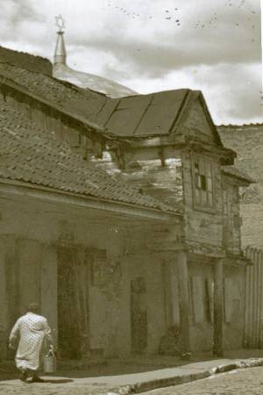
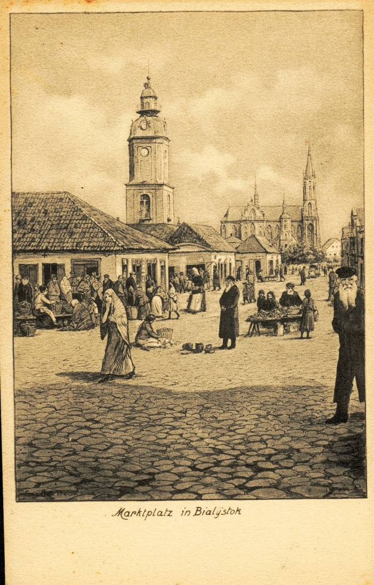
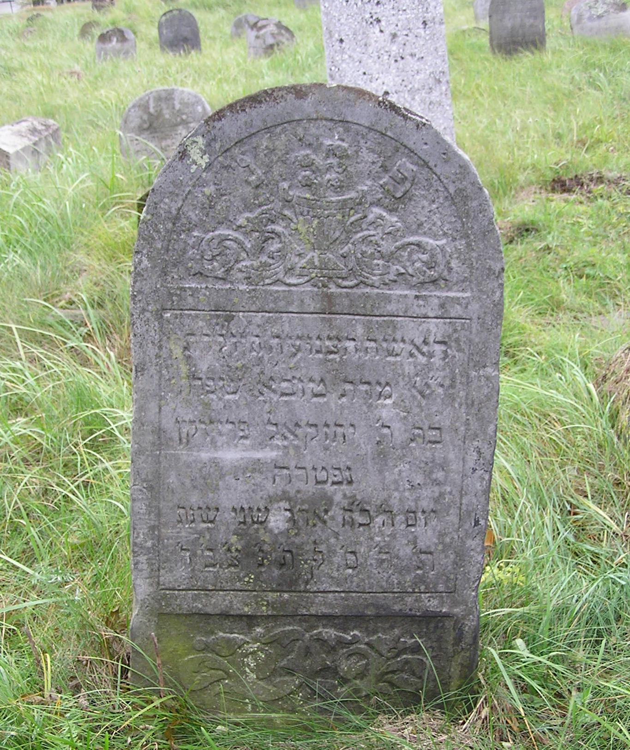
Harshness of Life
Notes:
In these earliest epitaphs from Białystok, subtle words or an unexpected phrase also reveal the harsh realities of life and a pure, emotional dimension to loss at the dawn of the 20th century. Premature death is indicated, at times, by simple phrases such as “Here lies a young man”, “an unmarried woman” or “a child”. Statistically, the months in which the majority of deaths occurred, namely from Tevet (December-January) through Adar (February-March) – the coldest of winter months, concur with expectations of the impact of the harshness of Białystok’s weather on human life. Contrary to the hoped for cycle of human life, we also find epitaphs that reveal a child’s passing before a parent. Another telling term /האלדת/ [sic], or variants thereof, indicates a woman who died “in confinement”, i.e. while pregnant, in childbirth or in the traditional period of ‘confinement’ that followed childbirth,

Slide 16
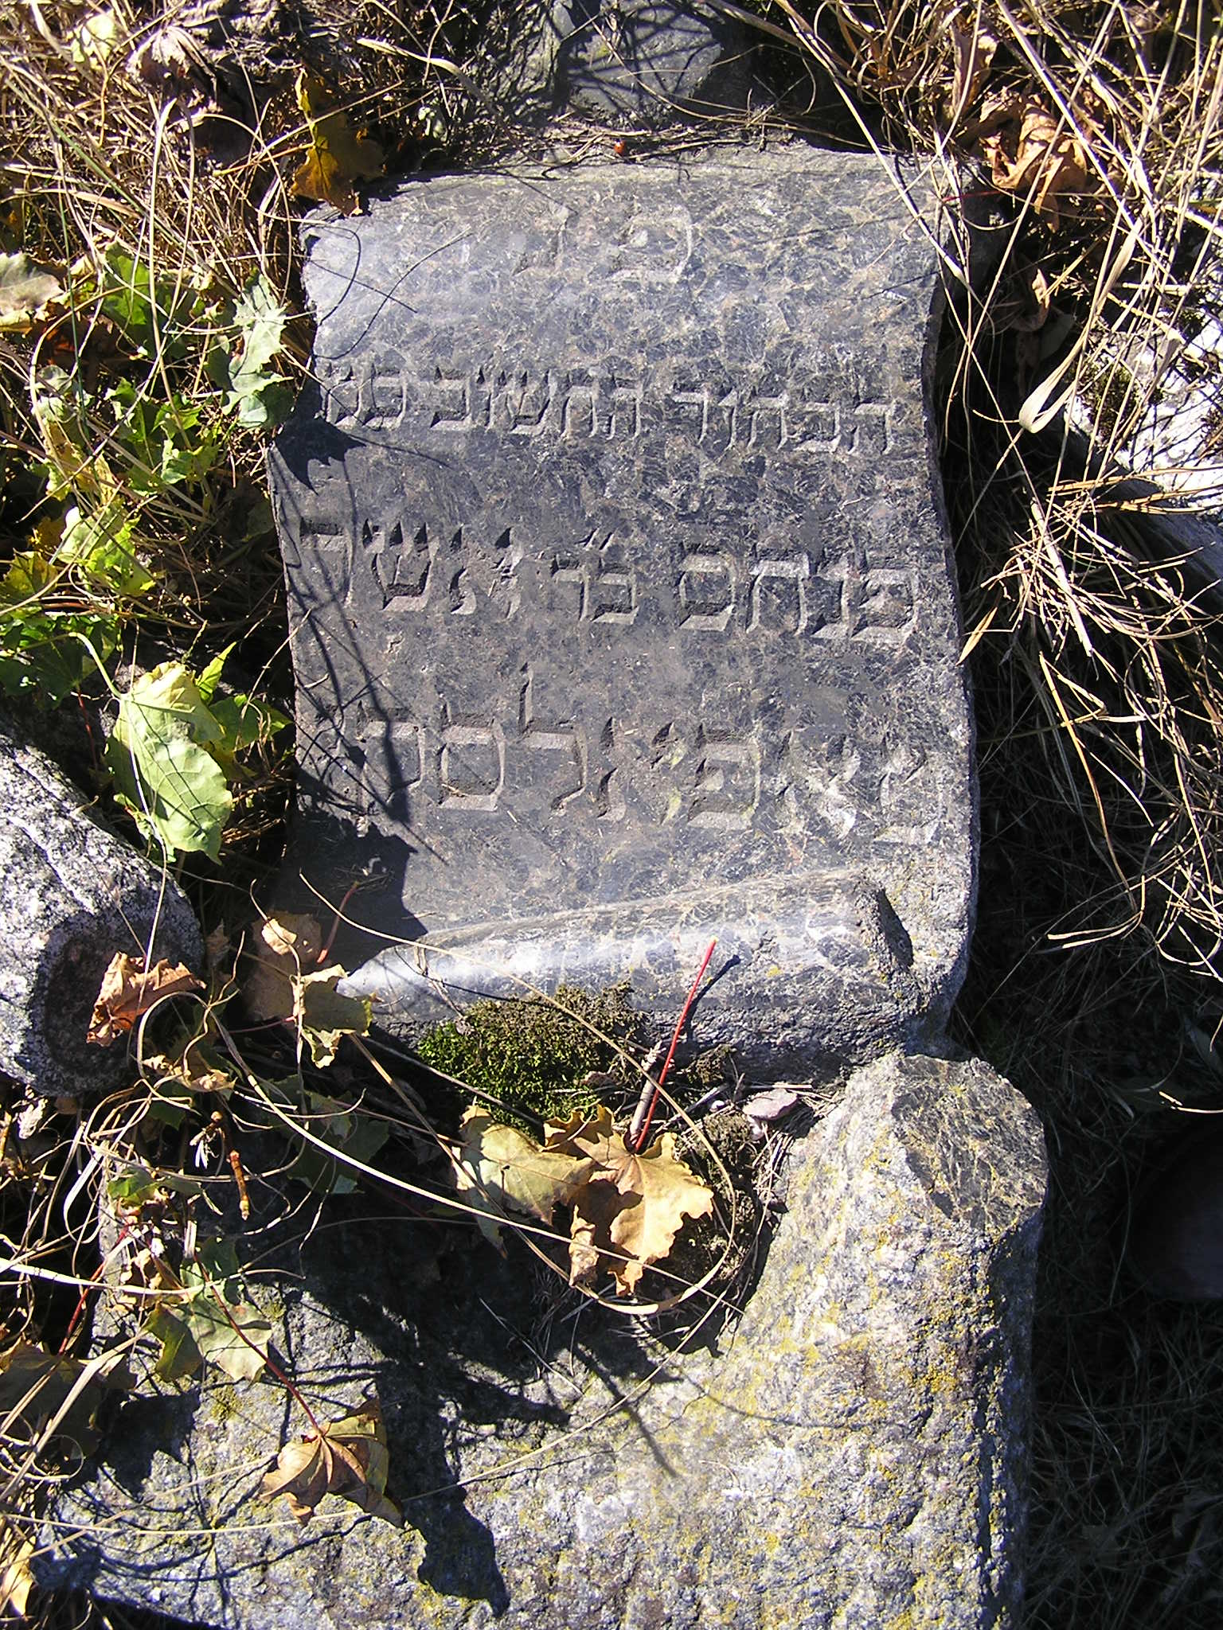
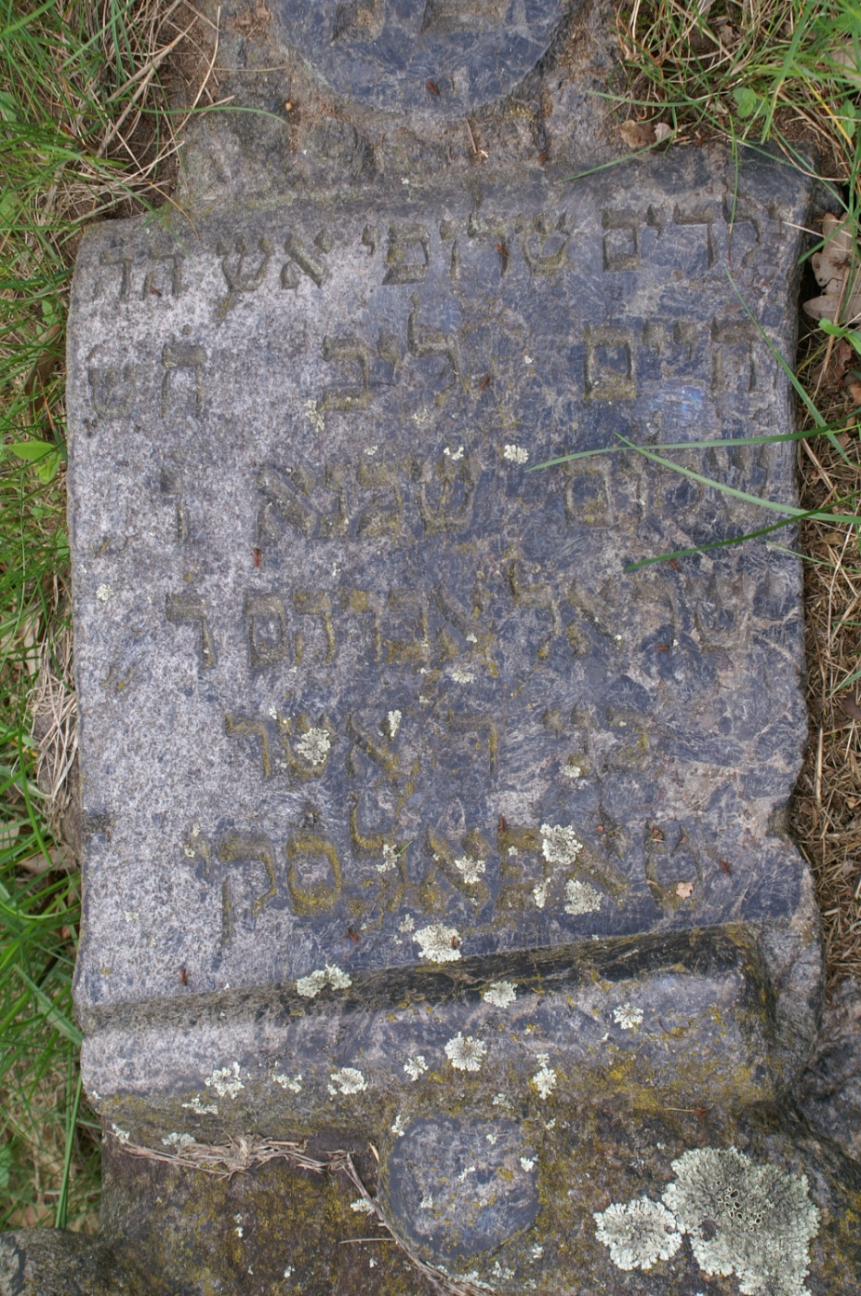
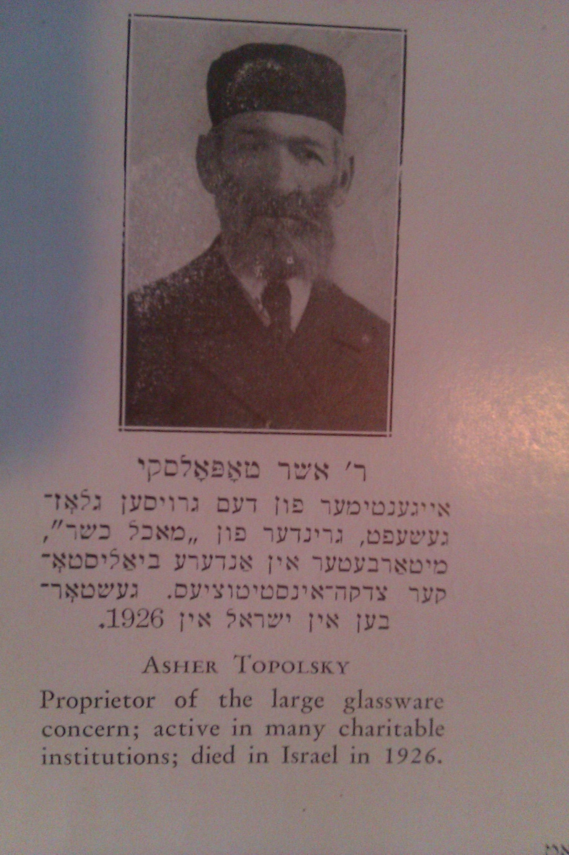
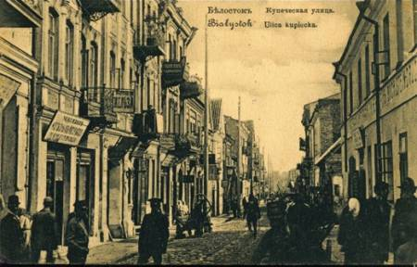
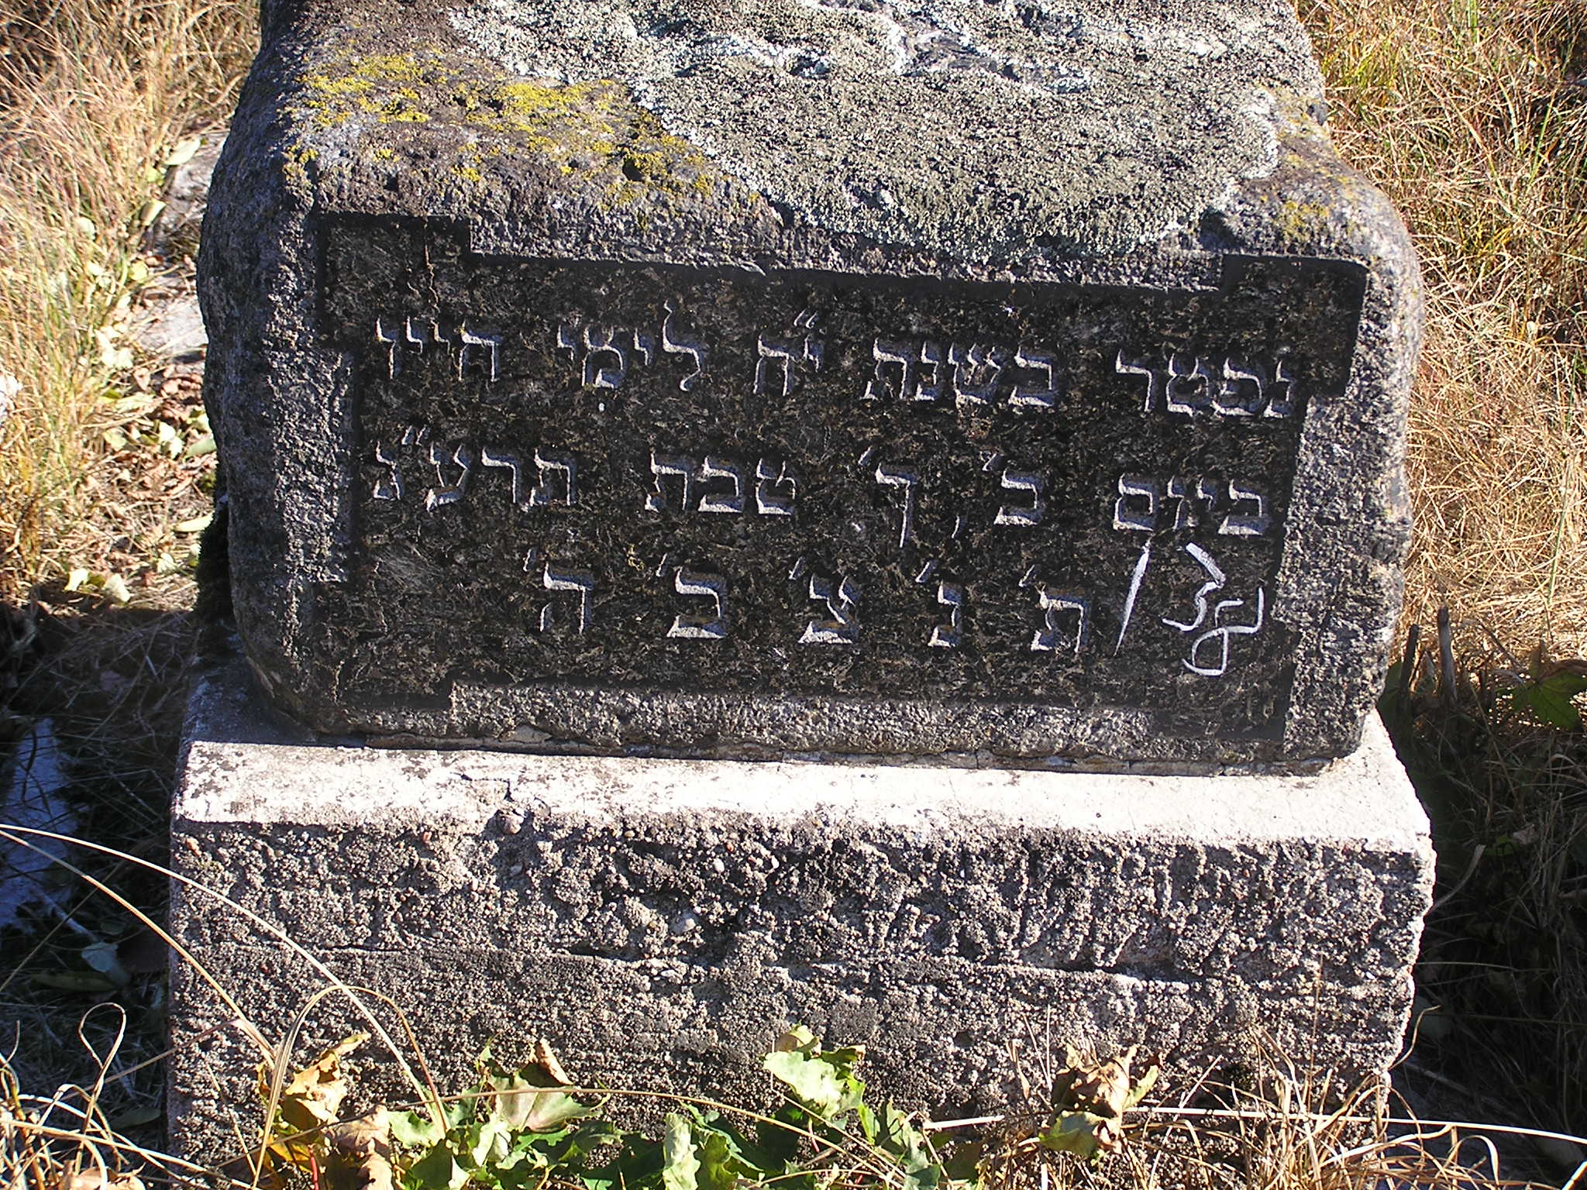
Notes:
"Here lies children burnt by fire. It is indeed Chaim Lejb, 8 years old, Shalom Shechna, 6 years old, and Israel Abraham, 4 years old, sons of R. Asher Topolski. They were burnt on Wednesday 15 Adar II year 5668 (18 March 1908). May there souls be bound in the bond of everlasting life."
1903 Vissia Rosia Bialystok Director – Osher Topelski, Dishes Business, Ul. Bazamaya (p. 333)
"Here lies the important young man our teacher R. Pinhas son of R. Asher Topolski . He died in the 18th year to the days of his life on Monday 20th Tevet 5673 (30 December 1913). May his soul be bound in the bond of everlasting life. "(Base): He died in the 18th year to the days of his life on Monday 20th Tevet 5673. May his soul be bound in the bond of everlasting life."
Social-personal history of this community

Slide 17
Epitaph as Memorial
Notes:
Of the approximately 2300 epitaphs still extant in this cemetery, approximately 100 epitaphs bear witness to violence from 1905 to 1939, both secondary to antisemitism and violence directly resulting from antisemitism. Of these 100 epitaphs nearly 65% remember the massacres of 1905 and the 1906 pogrom. The preponderance of these epitaphs are located in sections immediately adjacent to a tall black pillar that also memorialises these devastations. Until recently, this Memorial Pillar was recognised as remembering only the 1906 pogrom; remembrance of the 1905 massacres has for some reason been forgotten. Moreover, acknowledgement of memorial epitaphs is virtually unknown.
The devastations of Sabbath Nahamu 1905 and October 1905 were both part of anti-
Tsarist revolutionary actions that claimed the lives of Jews. However, the violence
of June 1906 was a “distinctive” pogrom. 32 What followed, as June 1906 began, is
recorded on the top of the western facade of the black Memorial Pillar in Bagnowka
Beth-Olam (Figure 10):
A Memorial of sorrow for us, inhabitants of Białystok and for all the house of Israel, this
pillar is a witness for us and for our sons that on the 21st, 22nd, 23rd, 24th, 25th to the
month of Sivan year 5666 (1–5 June, 1906) the inhabitants of this city fell upon our brothers,
the sons of Israel, plundering at noontime and plundering houses and possessions and
they murdered about 80 men and women and children.
Abraham Katz at the edge of the Boyari suburb of Białystok. The Katz house, located near a garden in Boyari, came under attack from two sides. The house caught fire in the crossfire and began to burn. The soldiers commanded the women and children to come out. Abraham Katz was the first to jump out of his burning house, only to be “instantaneously bayoneted by the soldiers, who were surrounding the burning house.” Atop the fragment of Abraham’s epitaph remains one of the two hands raised in priestly benediction and the crown of the esteemed Torah scholar, a rare memorial matzevah with a symbol emphasising a man’s esteemed lineage and profession. Abraham’s epitaph is crafted as an acrostic poem in a style prevalent at Bagnowka in general, arranged
both horizontally and vertically. /ABRHM/ is on line one, /BN/ on line two and /ZLMN/ vertically on lines 3–5, although only the top of line 6’s letters are visible, revealing the /n/ of Zalman (Figure 12). The extant lines conjoin the imagery of
altar and sacrifice:
Pain and distress designated a place of slaughter/
He [God] built for the sacrifices of man an altar,/
Such is hidden in the clods of the grave/
For himself and for his son-in-law desolation and destruction came/
Fire consumed his mother and his teaching/
Had more lines been extant of this acrostic poem, further details might have been offered, perhaps the identity of his son-in-law and mother. However, other epitaphs supply this information: Looking for a refuge you escaped to your father-in-law, there the murderers killed both of you after they burned his house on you. He is the honest upright young man, the martyr, our teacher Nachman Jakob son of Reb Mosze Grabowski, who was murdered during the days of the pogroms on the eve of the Holy Sabbath 22 Sivan 5666. Nachman Grabowski, 27 years old, fled to the home of his father-in-law Abraham Katz
on the second day of the pogrom. Nachman’s epitaph clarifies the reference to “fire” in his father-in-law Abraham Katz’s epitaph. Abraham Katz’s mother also perished in the fire:
Here lies the modest, God-fearing woman. The important Mrs. Toive, daughter of the Rabbi Reb Pinchas of blessed memory, wife of Reb Zalman Katz, was killed on Friday on the eve of the Holy Sabbath 22 Sivan 5666. May her soul be bound in the bond of everlasting life. Abraham’s mother Toive’s matzevah is one of the few that contains a symbol, a tri-branched candelabrum, symbolising the woman’s domain and a distinguished woman.
Today, within Bagnowka Beth-Olam a mass grave still holds the remains of the
martyrs of the 1906 pogrom. The Memorial Pillar, erected atop this mass grave in
the aftermath of both the 1905 and 1906 devastations, commemorates the victims
and preserves their names for posterity as part of a community.

Slide 18
Bund
Notes:
The Bund reached its greatest prominence during the revolution of 1905, but then began a marked decline that would last until 1917. Because of this decline, historical records of the Bund are scarce.26 Ester Riskind’s epitaph, however, reveals Bundists still present in Białystok during this period of decline, for the final detail engraved upon her matzevah states (in Yiddish), “it was erected 1910 year.” Thus, on the fifth anniversary of Ester’s shooting, her comrades still thought of her. They, not her family, erected a memorial matzevah in Bagnowka Beth-Olam near the Memorial Pillar to specifically remember Ester as “Our Friend.” In the crafting of this memorial matzevah, the Bund challenged traditional Jewish practices in Bagnowka Beth-Olam.

Slide 19
Filial Piety
Notes:
Emphasis on genealogical lineage (paternal, at times maternal), especially ha-cohen or ha-lewi or rabbinic descent (shalselet); sons and daughters are recognized for their paternal/maternal love/respect yet pleas to children to remember a parent. “The clods of your grave will sweeten and become green; your prayer will ascend and be surrounded by heaven in order to seek compassion upon your sons. O Compassionate mother, remember them for good in your remembrances!”
"Here lies Chaya Tsovya (aka Babel / Bobel) Medownik belonging to the family of R. Abraham Waldbaum She died 18th Elul 5669. 23/VIII 09. {In Yiddish} Children, Remember your mother!"
“daughter of R. Israel. Her mouth has ceased from the evil tongue.”
Return to ‘embracing the spirit of Dubnow’ and acknowledge that the Jewish epitaph can indeed contribute to the historiography of Jewish tradition …

Slide 20
Centrum Edukacji Obywatelskiej Polska-Izrael

Slide 21
Heidi M. Szpek, Ph.D. Select Publications
“Jewish Epitaphs from Białystok, 1892-1902: Embracing the Spirit of Dubnow.” East European Jewish Affairs [Forthcoming]
“Jewish Epitaphs from Białystok, 1905-06: Towards Mending the Torn Thread of Memory.” East European Jewish Affairs. Vol. 41, Nos. 1–2, April–August 2011, 1–23.
“Filial Piety in Jewish Epitaphs.” The International Journal of the Humanities. Volume 8.4 (2010): 183-202.
“He Walked Upon a Wooden Leg: Epitaphs and Acrostic Poems on Jewish Tombstones” Legacy of the Holocaust Conference 2007 Proceedings. Jagiellionian University Press. Krakow, Poland (May 24-26, 2007), Spring 2008.
“ ‘And in Their Death They Were Not Separated’: Aesthetics of Jewish Tombstones.” The International Journal of the Humanities. Vol. 5 (2007): 165-178.
“Oh Earth, Do Not Cover My Blood!”: Eastern European Jewish Identity and the Material Culture.” The International Journal of the Humanities. Volume 4.4 (2006): 7-18.

